Slide 1
Impact of Multiple Preganancies on Diabetes
Mini Project 1 Faiyaz Bhanji 2022

Slide 2
Some facts about the burden of diabetes on pregnant women
Since 2010 the number of pregnant women with gestational diabetes has jumped by 56% !
Research Shows Asian Hispanic and Black women are at a higher risk of developing diabetes during pregnancy
37% of pregnancies with gestastional disabetes will progress onto long term diabetes

Slide 3



Why is it important to investigate if multiple pregnancies contribute to diabetes in later life
Diabetes imposes a heavy health burden on the public and is the 7th highest cause of death
This study is important as a precursor to developing a prognostic model to predict diabetes in pregnant women
Pregnant women with diabetes as a result of multiple pregnancies are more likely to fall pregnant again thus putting the child at fatal risk
What we are trying to do is investigate the relationship between multiple pregnancies and diabetes and to study how significant this relationship is
How will we achieve this using:
Historical population
Exploratory data techniques
Statistical analysis
Visualisation techniques
How will we achieve this using:
te

Slide 4
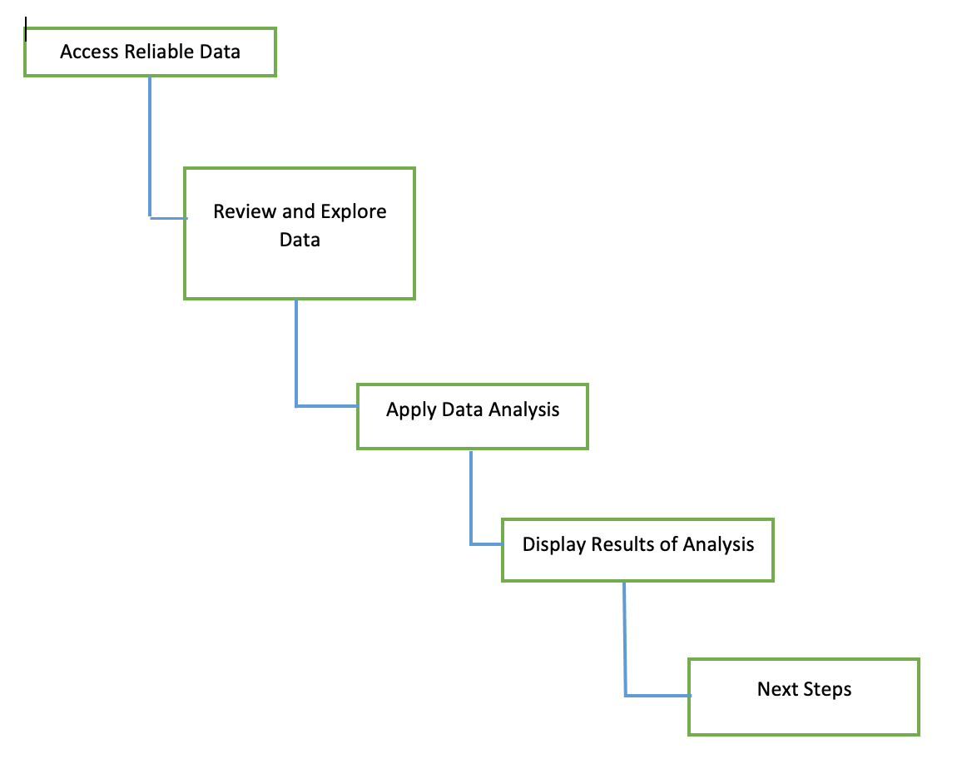
Road map

Slide 5
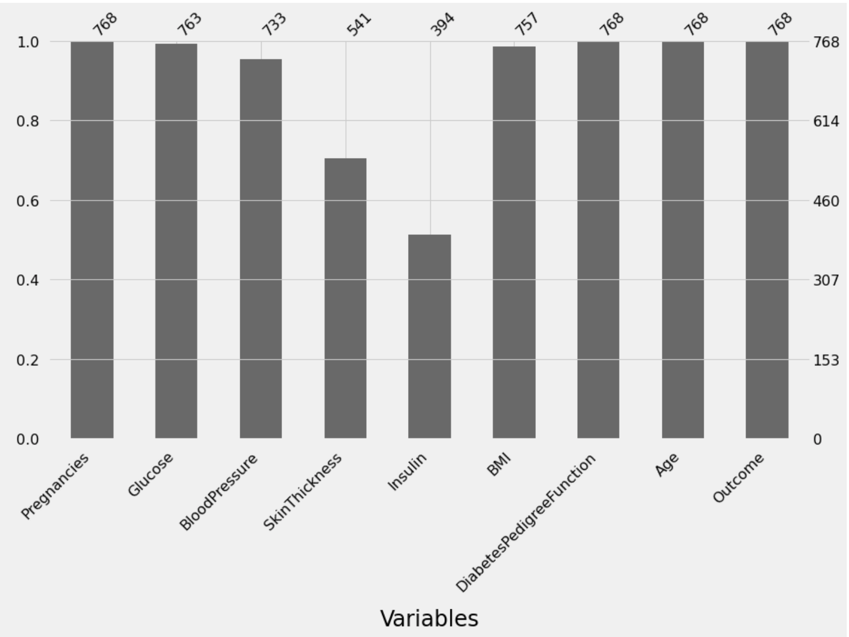
About the Data
The dataset is originally from the National Institute of Diabetes and Digestive Diseases
It contains 768 records
It has data on number of pregnancies, their BMI, Insulin, Age, Blood Pressure, Glucose, Diabetes Pedigree, Skin thickness,Outcome(+/-)
All the women in the dataset are Age >= 21
The data collected is all in numerical values including the target
There are missing values in some of the fields. See chart. In particular Skin Thickness and Insulin

Slide 6
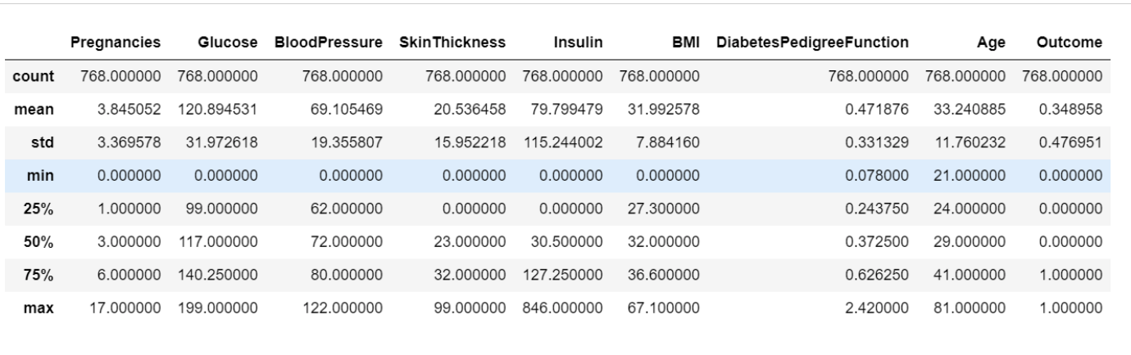
Exploring the data
Need to impute minimum values Glucose, Blood Pressure, Skin Thickness
Data has outliers maximum values for the columns

Slide 7
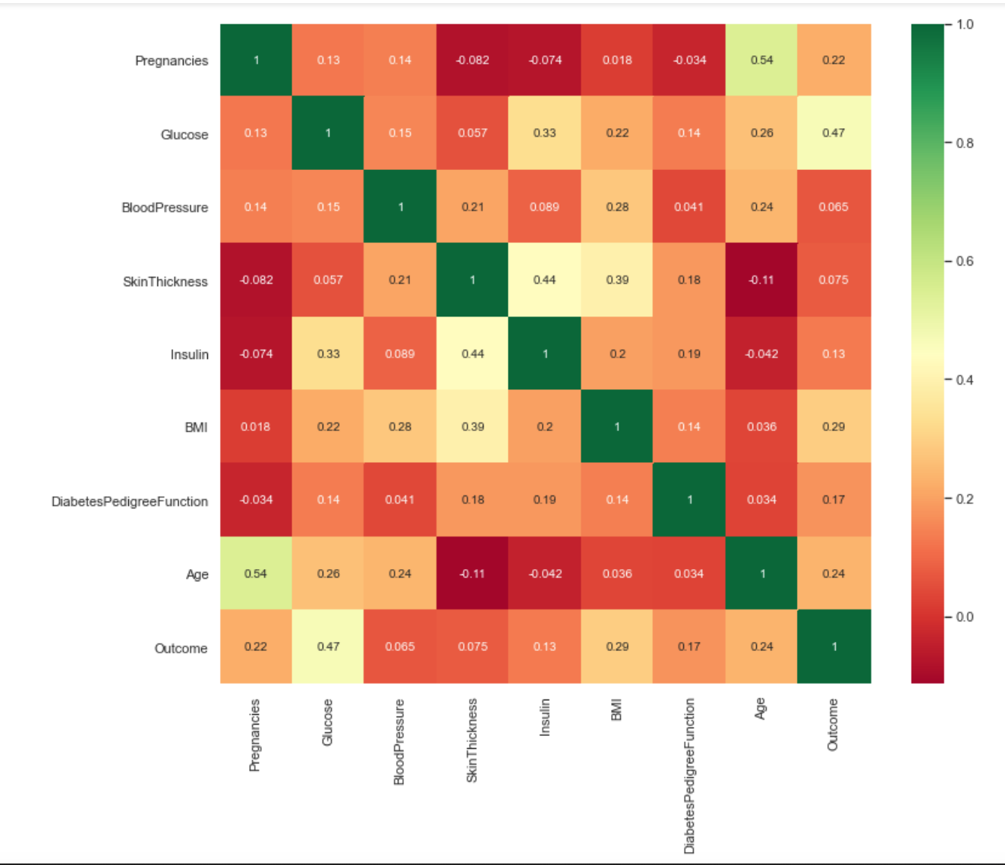
Exploring the data cont’d
This chart shows us the correlation between the features in the dataset.
no two factors have a strong linear relationships
Age & Pregnancies, BMI & Skin Thickness have a moderate positive linear relationship
Glucose & Insulin thave a low correlation however for this case because 0.58 is so close to 0.6 it assumed as a moderate correlation

Slide 8
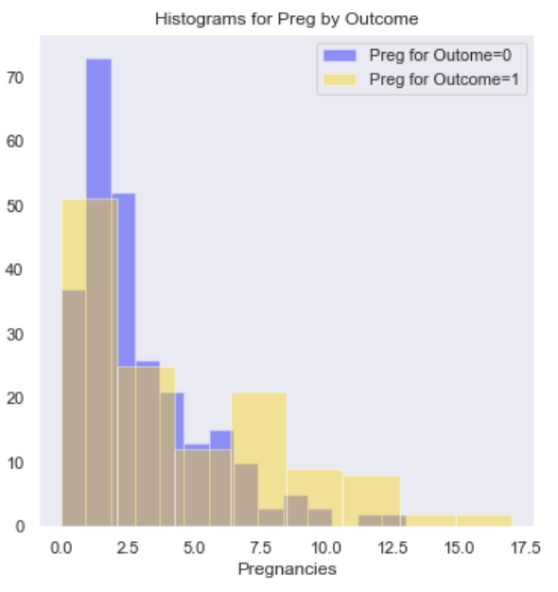
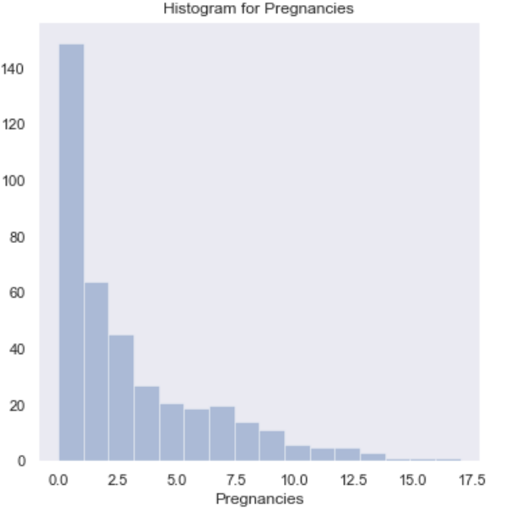
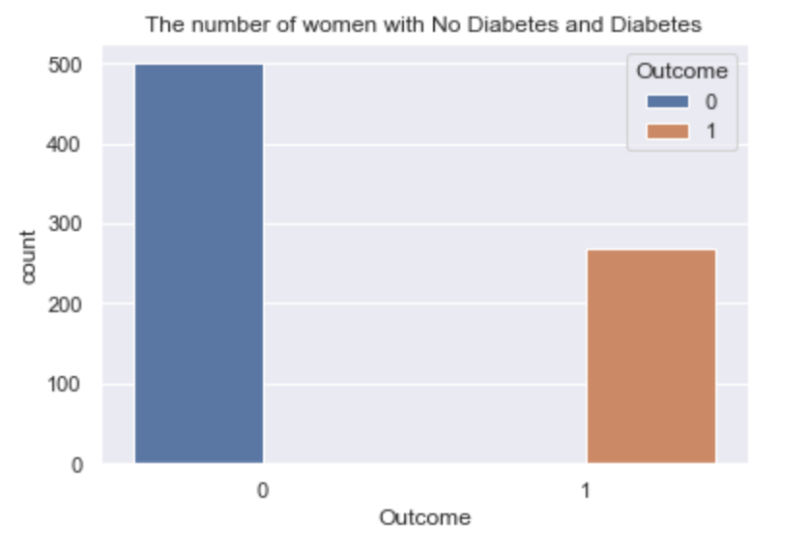
Visualising the data
Fig 3. Overlay of Pregnancies by Outcome
Fig 1 histogram of pregnancies
Fig 2. No. of women with or without diabetes

Slide 9
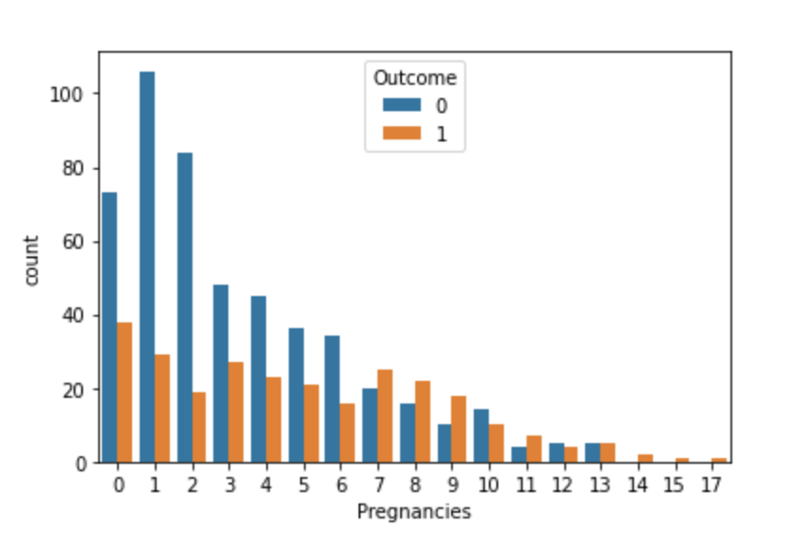
Hypothesis validation
Our Null hypothesis H0: There is no significant relationship between Pregnancies and Outcome
Our Alternative hypothesis H1: There is significant relationship between Pregnancies and Outcome
Applying Statistical to our data we were able to calculate critical statistical numbers to confirm our hypothesis that women with multiple pregnancies are more likely to develop diabetes.
In fact we can see from the chart here that women with more than 6 pregnancies are more likely to develop diabetes

Slide 10
Next Steps
The next stage in the project could be developing a model that could predict with some degree of accuracy how likely the pregnant woman is to developing diabetes
An interesting fact as an aside, a study in 2019 in the US found with 95% confidence interval that multiple pregnancies contribute to the risk of developing diabetes.
Zhu, Y. and Zhang, C. (2016). Prevalence of Gestational Diabetes and Risk of Progression to Type 2 Diabetes: a Global Perspective. Current Diabetes Reports, 16(1).
‌

